Slide 1

WAY TO ENTERPRISE
Java Basics
VTI ACADEMY
Author: duy.nguyenngoc1@vti.com.vn
March 2020

Slide 2
Agenda
Static
Final
File
IO Stream
Assignments
Copyright © VTI Academy All Rights Reserved

Slide 3
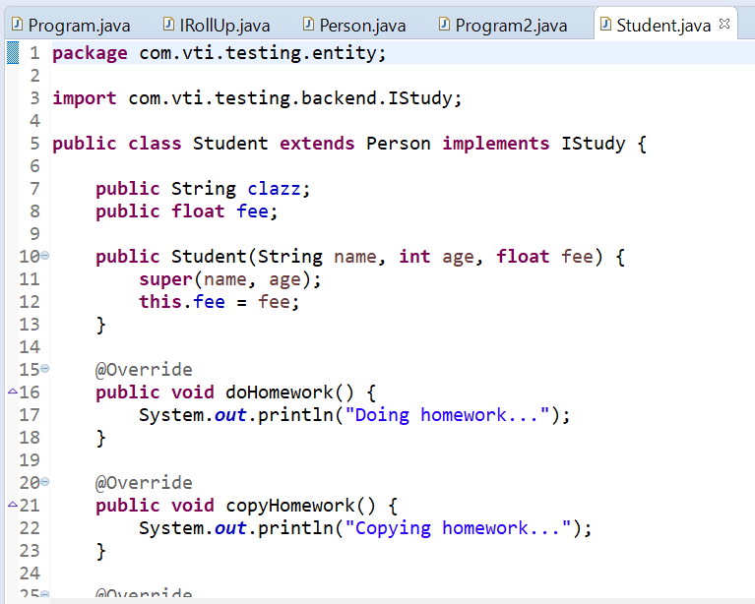
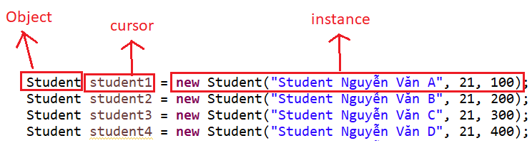
Object & Instance

Slide 4
Static
Property belong to instance
Static belong to Object
Saving memory

Slide 5
Static
Static method
Static property

Slide 6
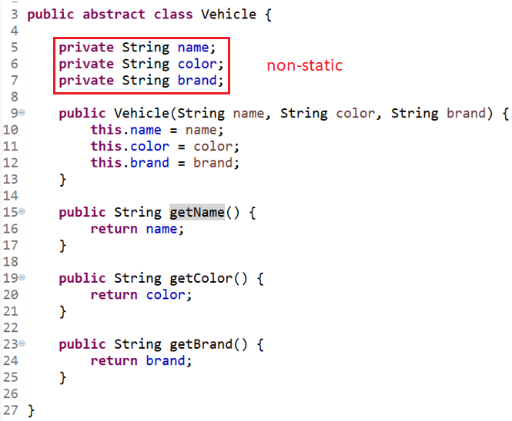
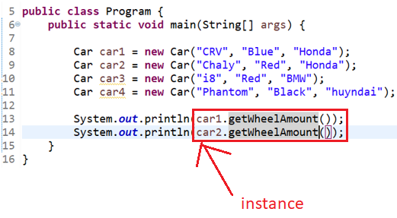
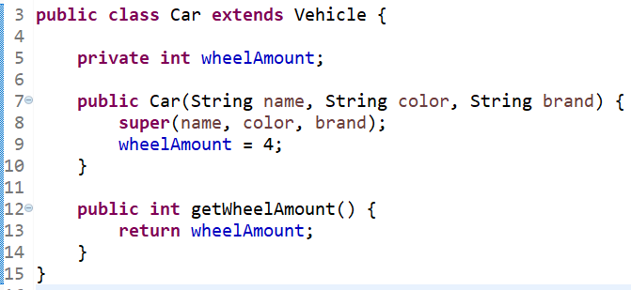
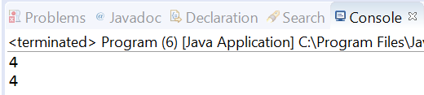
Non Static

Slide 7
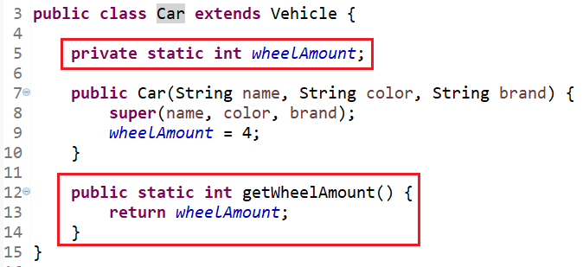
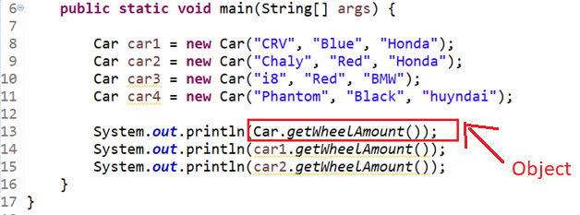
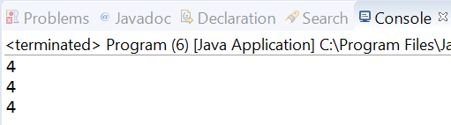
Saving memory

Slide 8
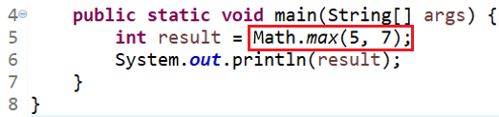
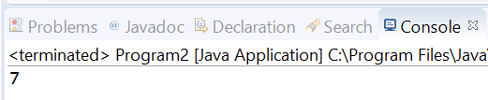
Static Method

Slide 9
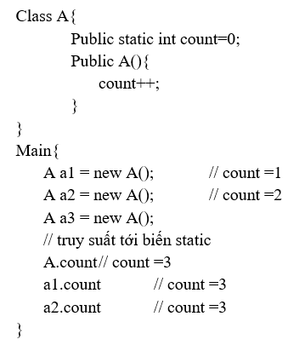
Example
Count Object

Slide 10
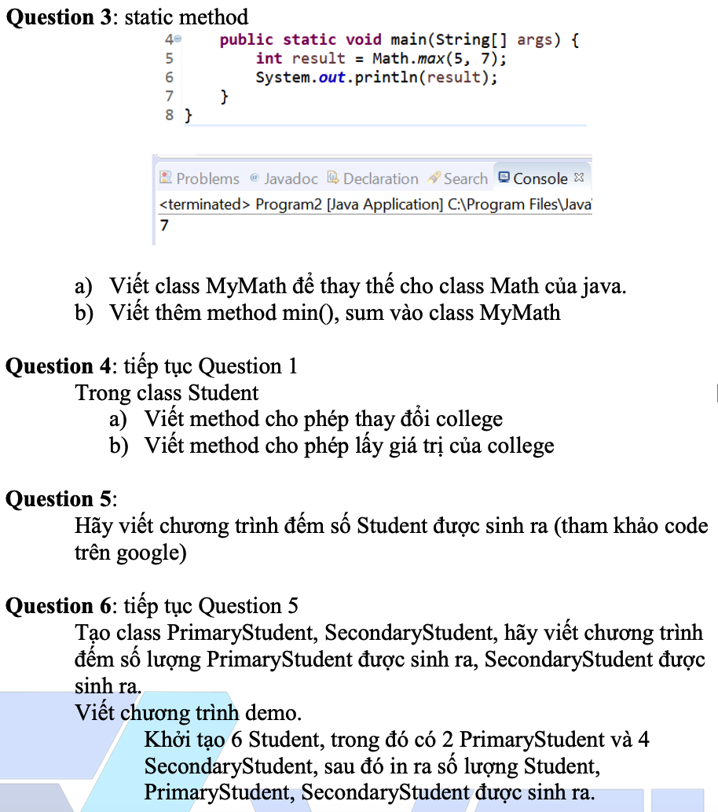
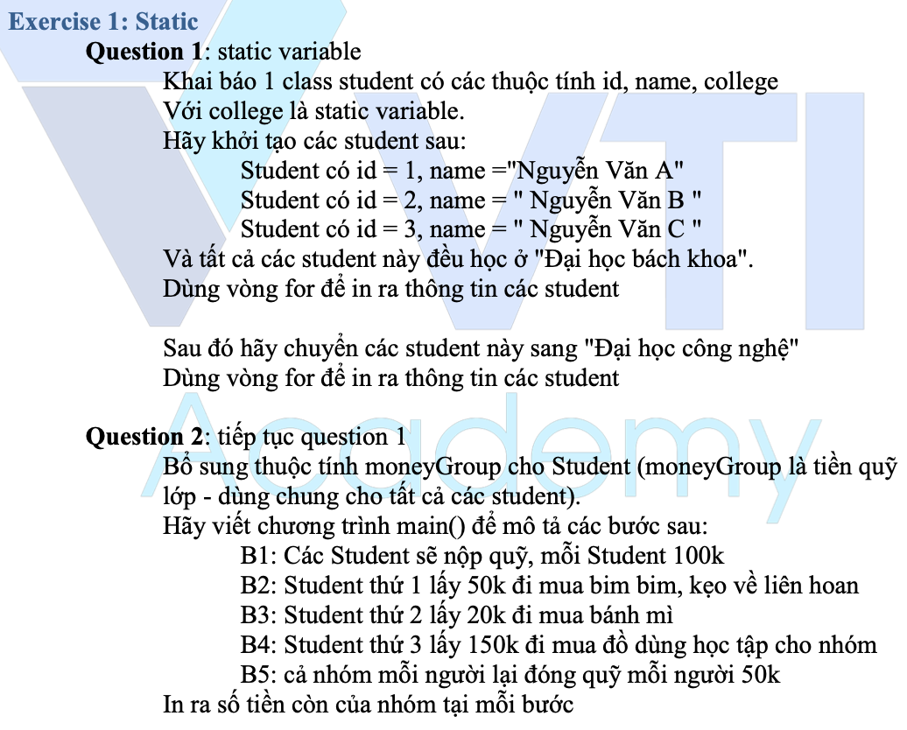
Testing System Assignments
Exercise 1: Static

Slide 11
Final
Final variable
Final variable and Constructor
Final method
Final class
Final parameter
Static final (declare constraint)

Slide 12
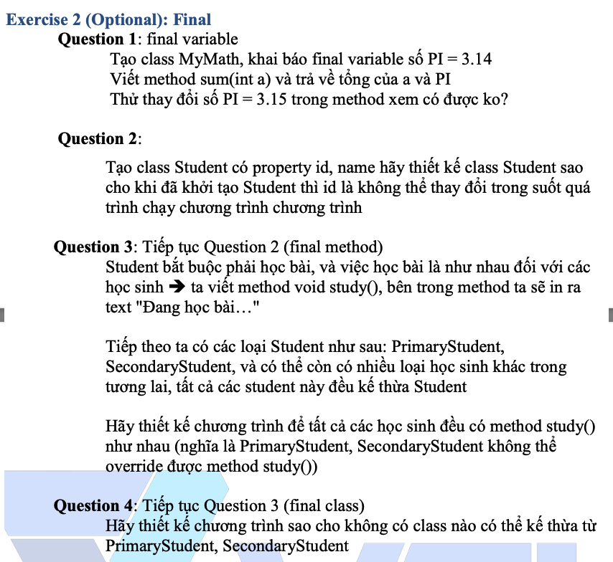
Testing System Assignments
Exercise 2 (Optional): Final

Slide 13
File
Check File is exists
Create file
Delete file
Check path is File or Folder
Get all File of Folder
Rename File
Moving File

Slide 14
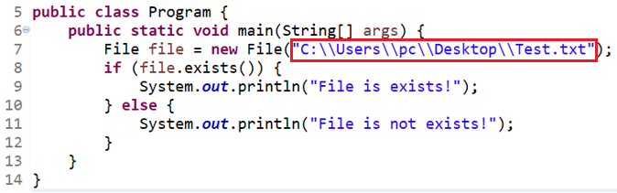
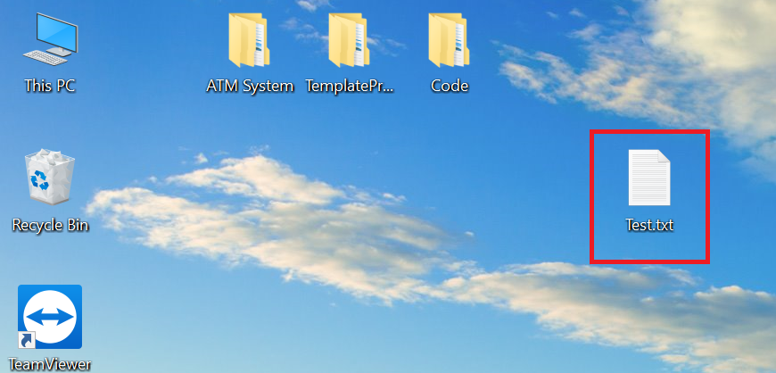
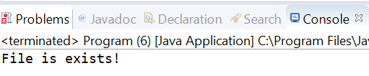
Check File is exists

Slide 15
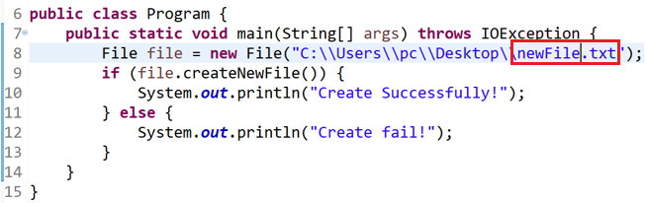
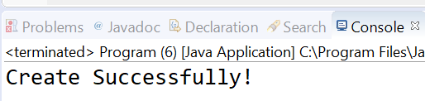
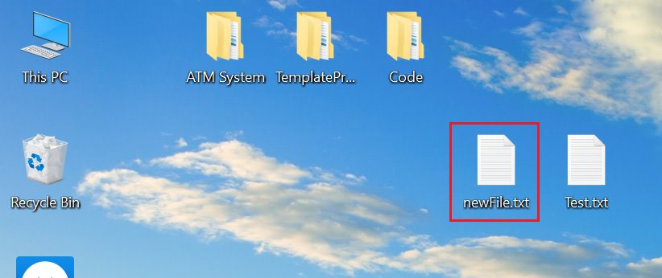
Create File

Slide 16
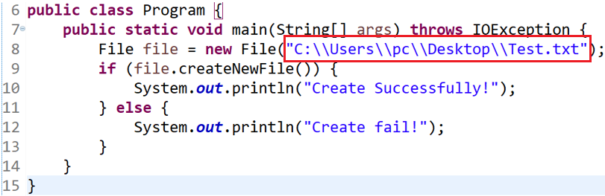
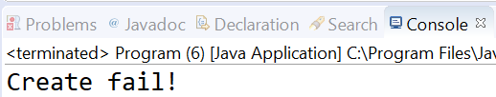
Create File

Slide 17
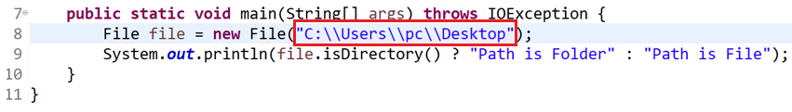

Check path is File or Folder

Slide 18
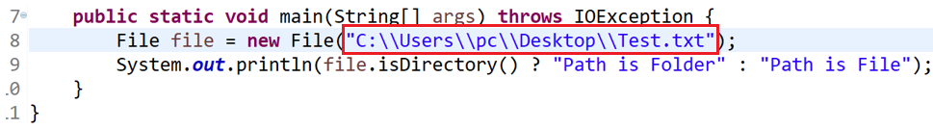
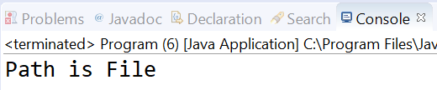
Check path is File or Folder

Slide 19
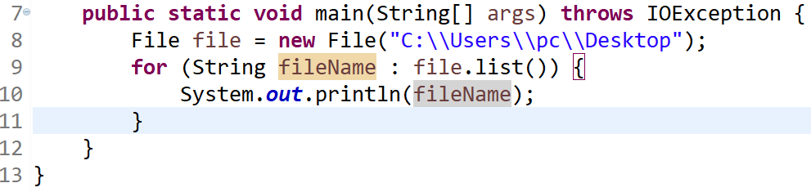
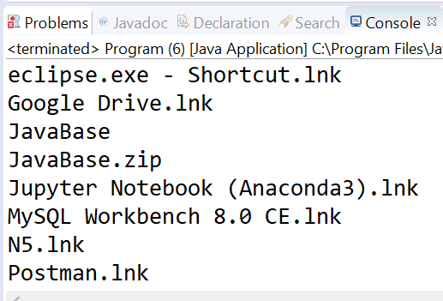
Get all File of Folder

Slide 20
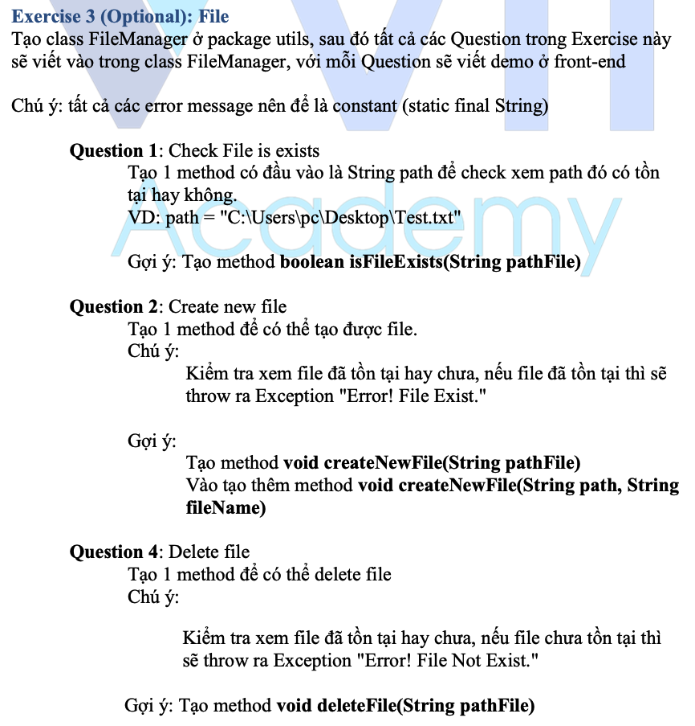
Testing System Assignments
Exercise 3 (Optional): File

Slide 21
IO Stream
ByteStreams (read byte)
ObjectStreams (read Object)
CharacterStreams (Read characters)
BufferdStreams (Read multiple data)

Slide 22
ByteStreams
Read file
Write file

Slide 23
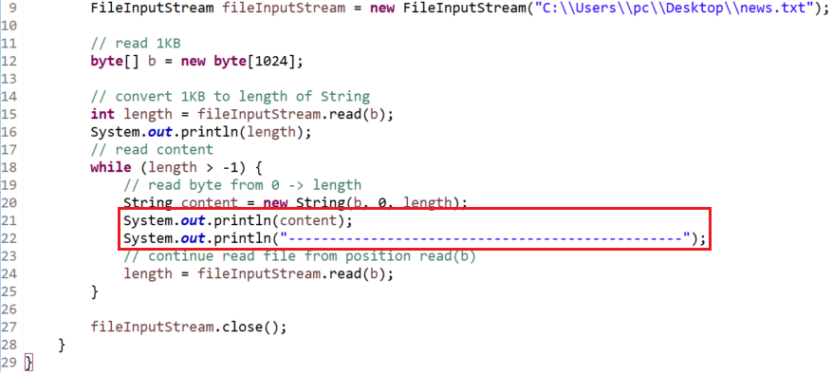
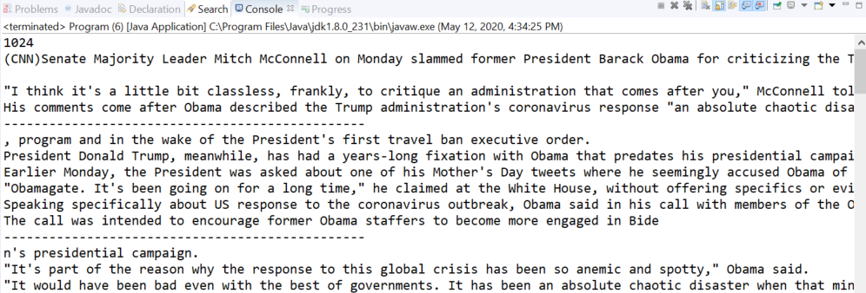
Read file

Slide 24
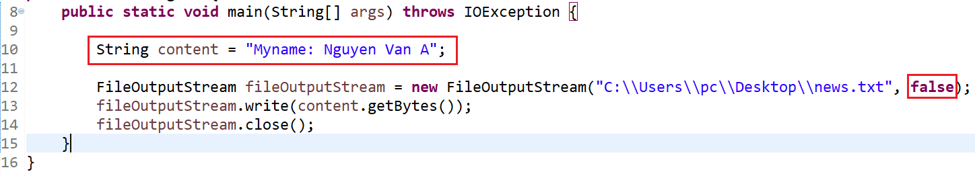
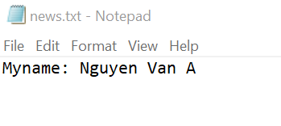
Write file (replace content)

Slide 25
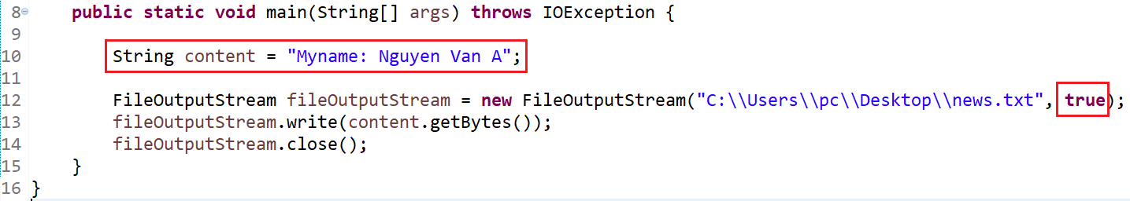
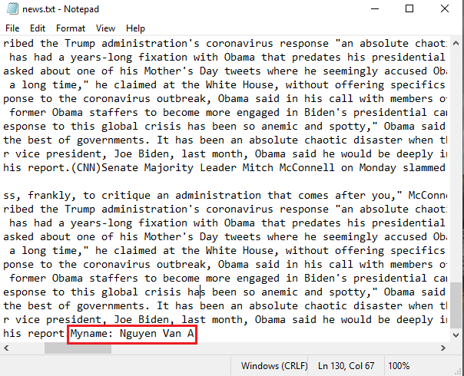
Write file (continuing content)

Slide 26
ObjectStreams
Read Object
Write Object

Slide 27
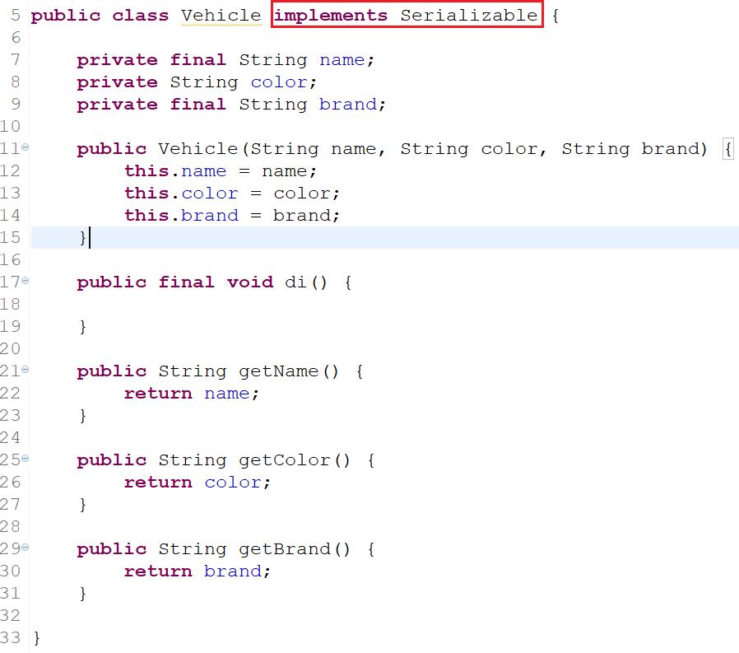
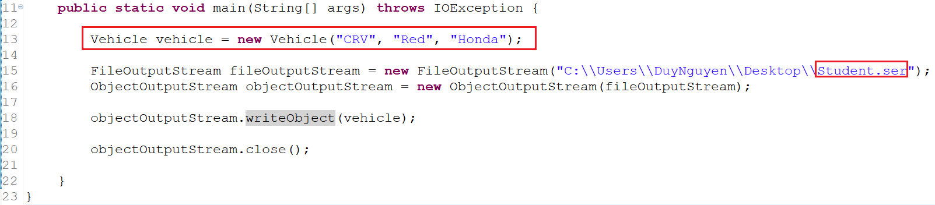
Write Object

Slide 28
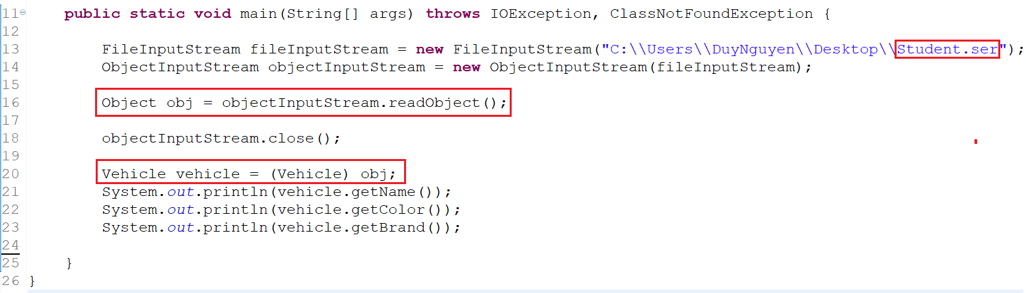
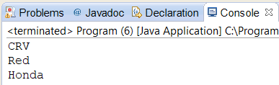
Read Object

Slide 29
ObjectStreams
Serializable
Transient

Slide 30
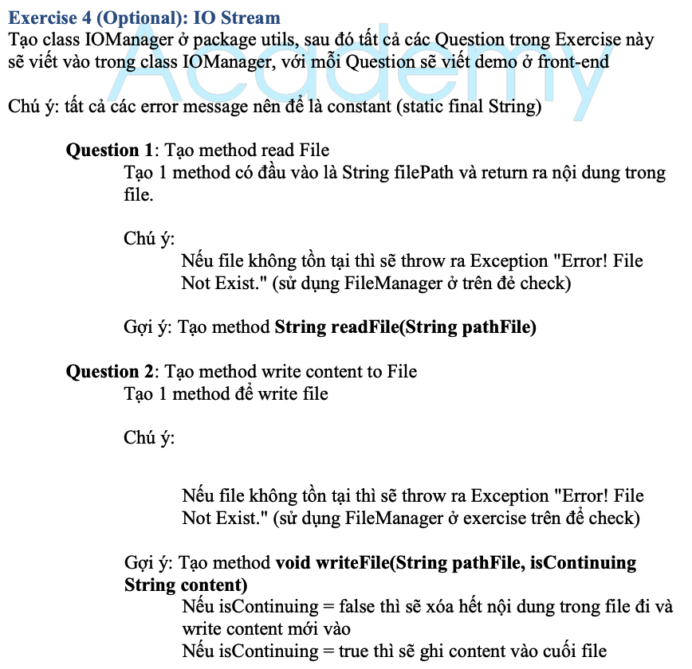
Testing System Assignments
Exercise 4 (Optional): IO Stream

Slide 31
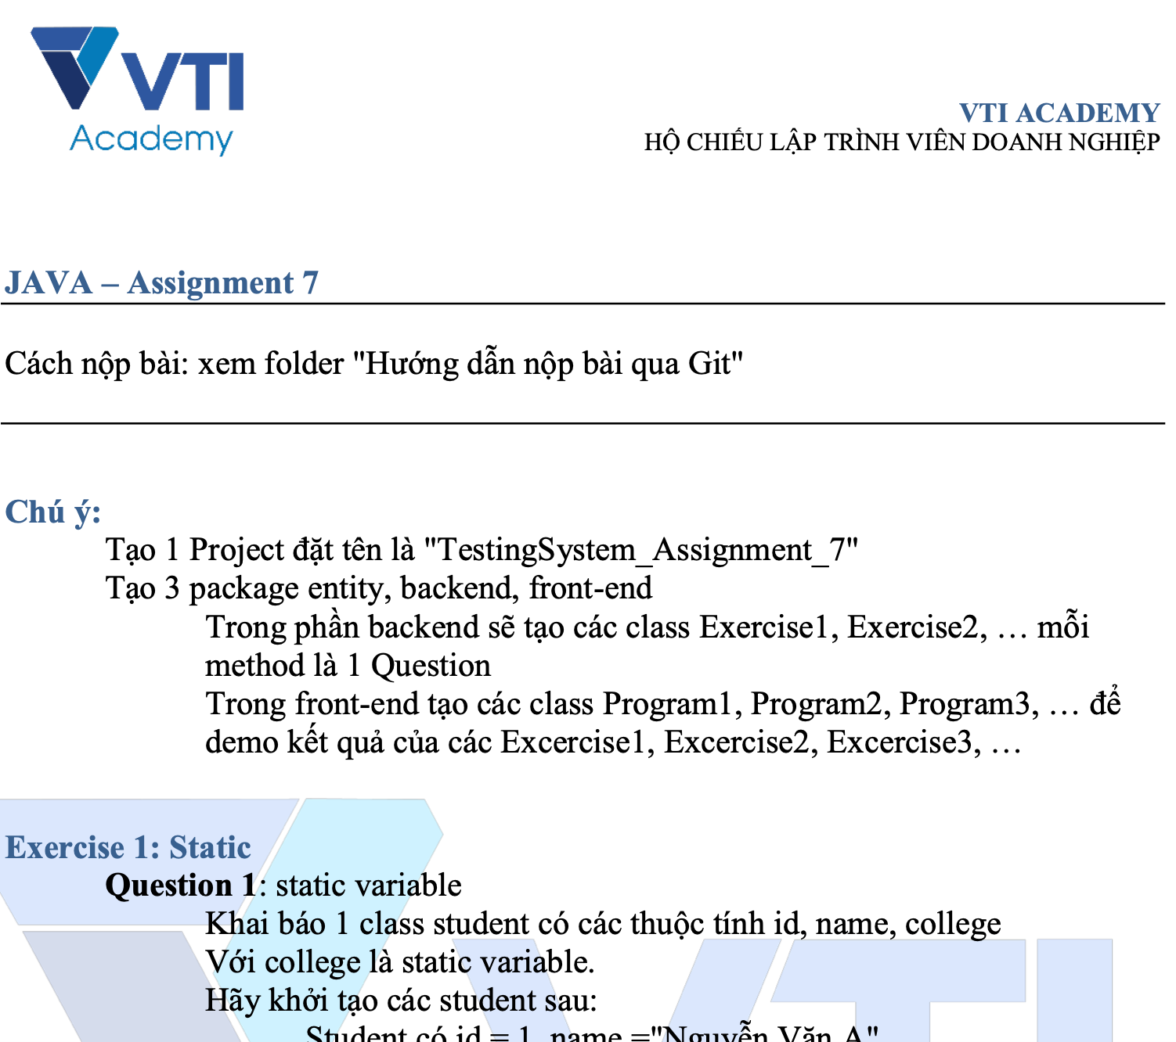
Testing System Assignments

Slide 32
Q & A
Copyright © VTI Academy All Rights Reserved

